Slide 1
Software Metrics
Disclaimer
There’s a plethora of testing tools and static analyzers that compute metrics.
We will not be focusing here on tools but rather on concepts.

Slide 2
General Introduction

Slide 3
Definitions
Measure - quantitative indication of extent, amount, dimension, capacity, or size of some attribute of a product or process.
E.g., Number of errors
Metric - quantitative measure of degree to which a system, component or process possesses a given (quality?) attribute. “A handle or guess about a given (quality?) attribute.”
E.g., Number of errors found per person hours
JP’s take: metrics need interpretation

Slide 4
Motivation for Metrics
Estimate the cost & schedule of future projects
Evaluate the productivity impacts of new tools and techniques
Establish productivity trends over time
Improve software quality
Forecast future staffing needs
Anticipate and reduce future maintenance needs

Slide 5
Example Metrics
Defect rates
(where a defect is something less serious than an error wrt reqs)
Error rates: Errors should be categorized by origin, type, cost
It is a luxury to invest in root cause analysis
Measured wrt:
individual
Module/class/procedure

Slide 6
Product vs. Process
Process Metrics
Insights of process paradigm, software engineering tasks, work product, or milestones
Lead to long term process improvement
Product Metrics
Assess the state of the project
Track potential risks
Uncover problem areas
Adjust workflow or tasks
Evaluate teams ability to control quality

Slide 7
Types of Measures
Direct Measures (internal attributes)
Cost ($$), effort (in man/days), LOC (lines of code), response speed, memory footprint
white box viewpoint
Indirect Measures (external attributes)
Functionality, complexity, efficiency, reliability, maintainability (more on this later in the course)
Black box viewpoint
Both pertain to quality?

Slide 8
Size-Oriented Metrics
Size of the software produced:
LOC - Lines Of Code
KLOC - 1000 Lines Of Code
SLOC – Statement Lines of Code (ignore whitespace)
Popular because easy to compute
Typical Measures:
Errors/KLOC, Defects/KLOC, Cost/LOC, Documentation Pages/KLOC

Slide 9
Complexity Metrics
LOC - a ‘rough’ function of complexity
Halstead’s Software Science
(entropy measures, i.e., measures towards (quality?) equilibrium…)
n₁ - number of distinct operators
n₂ - number of distinct operands
N₁ - total number of operators
N₂ - total number of operands

Slide 10
Example
if (k < 2)
{
if (k > 3)
x = x*k;
}
Distinct operators: if ( ) { } > < = * ;
Distinct operands: k 2 3 x
n₁ = 10
n₂ = 4
N₁ = 13
N₂ = 7

Slide 11
Halstead’s Metrics
Amenable to experimental verification [1970s]
Program length: N = N₁ + N₂ (in ex: 20)
Program vocabulary: n = n₁ + n₂ (in ex: 14)
Volume V = N * log₂ n (in ex: 76.14)
Difficulty D = (n1/2) + (N2/n2) (in ex: 6.75)
Effort E = D x V (in ex: 514)
Time to program T = (E / 18) seconds (in ex: 29 s)
Number of delivered bugs B = V / 3000 (in ex: 0.025)
Welcome to the science of metrics, for which interpretation is often an art… For example, D and E are taken to pertain to understandability…

Slide 12
McCabe’s Complexity Measures
McCabe’s metrics are based on a control flow representation of the program.
A control flow graph is used to depict control flow.
Nodes represent processing tasks (one or more code statements)
Edges represent control flow between nodes

Slide 13
Flow Graph Notation
While
Sequence
If-then-else
Until

Slide 14
Cyclomatic Complexity
Defined as the set of independent paths through the control flow graph
V(G) = E – N + 2
E is the number of flow graph edges
N is the number of nodes
V(G) = P + 1
P is the number of predicate nodes

Slide 15
Example
i = 0;
while (i<n-1) do
j = i + 1;
while (j<n) do
if A[i]<A[j]
then
swap(A[i], A[j]);
end do;
i=i+1;
end do;

Slide 16
Flow Graph
1
2
3
7
4
5
6

Slide 17
Computing V(G)
V(G) = 9 – 7 + 2 = 4
V(G) = 3 + 1 = 4
Basic paths are:
1, 7
1, 2, 6, 1, 7
1, 2, 3, 4, 5, 2, 6, 1, 7
1, 2, 3, 5, 2, 6, 1, 7

Slide 18
Meaning of V(G)
Complexity increases with the number of decision paths and loops
V(G) is a quantitative measure of the testing difficulty and, ultimately, an indication of reliability
Experimental data shows value of V(G) should be no more then 10: testing is very difficult above this value

Slide 19
McClure’s Complexity Metric
Complexity = C + V
C is the number of comparisons in a module
V is the number of control variables referenced in the module (from ifs and loops)
Targets decisional complexity
Somewhat pertains to path sensitization
Similar to McCabe’s but with regard to control variables.
Can this be correlated to software quality?
Notes:
And there is McCall’s Triangle of Quality…

Slide 20
A Comment
McCall’s quality factors were proposed in the
early 1970s. They appear to be as valid today as they
were at that time. It’s likely that software built to conform
to these factors will exhibit high quality well into
the 21st century, even if there are dramatic changes
in technology.

Slide 21
Quality Model (is ISO 9126 relevant to this?)
product
operation
revision
transition
reliability
efficiency
usability
maintainability
testability
portability
reusability
Metrics

Slide 22
High Level Design Metrics
Structural Complexity
Data Complexity
System Complexity
Structural Complexity S(i) of a module i.
S(i) = f_{out}²(i)
Fan out is the number of modules immediately subordinate (directly invoked).

Slide 23
Design Metrics
Data Complexity D(i)
D(i) = v(i)/[f_{out}(i)+1]
v(i) is the number of inputs and outputs passed to and from i
System Complexity C(i)
C(i) = S(i) + D(i)
As each C(i) increases the overall complexity of the architecture increases

Slide 24
System Complexity Metric
Another metric:
length(i) * [f_{in}(i) + f_{out}(i)]²
Length is LOC
Fan in is the number of modules that invoke i
The real question: what are ‘good’ numbers for each of these metrics?

Slide 25
Coupling for a module
Data and control flow: (a key distinction)
d_{i} input data parameters
c_{i} input control parameters
d_{o} output data parameters
c_{o} output control parameters
Global
g_{d} global variables for data
g_{c} global variables for control
Environmental
w fan in
r fan out

Slide 26
Metrics for Coupling
M_{c} = k/m, k=1
m = d_{i} + ac_{i} + d_{o} + bc_{o} + g_{d} + cg_{c} + w + r
Key point: a, b, c, k can be adjusted based on actual data… but how is this done?
This computation can be so subjective that most will rely on simpler (if not simplistic) metrics…

Slide 27
Component Level Metrics
Cohesion (internal interaction) – pertains to data members
Coupling (external interaction) - a function of input and output parameters, global variables, and modules called
Complexity of program flow - hundreds have been proposed (e.g., cyclomatic complexity)
Cohesion – difficult to measure
Bieman ’94, TSE 20(8)

Slide 28
Using Metrics
The Process
Select appropriate (??) metrics for problem
Use metrics on problem
Assess and generate feedback
Steps:
Formulation
Collection
Analysis
Interpretation
Feedback

Slide 29
Metrics for OO Software

Slide 30
Metrics for the Object Oriented
Chidamber & Kemerer ’94 TSE 20(6)
Metrics specifically designed to address object-oriented software
Class-oriented metrics:
No need for procedure level metrics
Cluster level metrics is simply too complex
Simple direct measures

Slide 31
Chidamber and Kemerer Metrics
Weighted methods per class (MWC)
Depth of inheritance tree (DIT)
Number of children (NOC)
Coupling between object classes (CBO)
Response for class (RFC)
Lack of cohesion metric (LCOM)

Slide 32
Weighted methods per class (WMC)
c_{i} is the complexity of each method M_{i} of the class
Often, only public methods are considered
Complexity may be the McCabe complexity of the method
Smaller values are better
Perhaps the average complexity per method is a better metric

Slide 33
Weighted Methods per Class
Viewpoints from Chidamber and Kemerer: -The number of methods and complexity of methods is an indicator of how much time and effort is required to develop and maintain the object -The larger the number of methods in an object, the greater the potential impact on the children -Objects with large number of methods are likely to be more application specific, limiting possible reuse

Slide 34
Depth of inheritance tree (DIT)
For the system under examination, consider the hierarchy of classes
DIT is the length of the maximum path from the node to the root of the tree
Relates to the scope of the properties
How many ancestor classes can potentially affect a class
Smaller values are better

Slide 35
Number of children (NOC)
For any class in the inheritance tree, NOC is the number of immediate children of the class
The number of direct subclasses
How would you interpret this number?
A moderate (??) value indicates scope for reuse and high values may indicate an inappropriate abstraction in the design

Slide 36
Number of Children
Viewpoints:
As NOC grows, reuse increases - but the abstraction may be diluted
Depth is generally better than breadth in class hierarchy, since it promotes reuse of methods through inheritance
Really?? Open-closed principle? Does this not contradict heuristic for DIT?
Classes higher up in the hierarchy should have more sub-classes then those lower down
NOC gives an idea of the potential influence a class has on the design: classes with large number of children may require more testing

Slide 37
Coupling between Classes
CBO is the number of collaborations between two classes (fan-out of a class C)
the number of other classes that are referenced in the class C (where a reference to another class, A, is a reference to a method or a data member of class A)
Viewpoints:
High fan-outs denote class coupling to other classes/objects and thus are undesirable. High fan-ins denote good designs and a high level of reuse
Not possible to maintain high fan-in and low fan outs across the entire system
Excessive coupling indicates weakness of class encapsulation and may inhibit reuse
High coupling also indicates that more faults may be introduced due to inter-class activities

Slide 38
Response for class (RFC)
Mc_{i:} # of methods called in response to a message that invokes method M_{i}
Fully nested set of calls
Smaller numbers are better
Larger numbers indicate increased complexity and debugging difficulties
If a large number of methods can be invoked in response to a message, the testing and debugging of the class becomes more complicated

Slide 39
Lack of cohesion metric (LCOM)
Number of methods in a class that reference a specific instance variable
A measure of the “tightness” of the code
If a method references many instance variables, then it is more complex and less cohesive
The larger the number of similar methods in a class the more cohesive the class is
“Cohesion of methods within a class is desirable, since it promotes encapsulation” (??)

Slide 40
Lack of Cohesion in Methods
LCOM – poorly described in Pressman
Class C_{k} with n methods M₁,…M_{n}
I_{j} is the set of instance variables used by M_{j}

Slide 41
LCOM
There are n such sets I₁ ,…, I_{n}
P = {(I_{i}, I_{j}) | (I_{i} ∩ I_{j} ) = ∅} //no common inst. var.
Q = {(I_{i}, I_{j}) | (I_{i} ∩ I_{j} ) ≠ ∅}
If all n sets I_{i} are ∅ then P = ∅
LCOM = |P| - |Q|, if |P| > |Q|
LCOM = 0 otherwise

Slide 42
Example LCOM
Take class C with M₁, M₂, M₃
I₁ = {a, b, c, d, e}
I₂ = {a, b, e}
I₃ = {x, y, z}
P = {(I₁, I₃), (I₂, I₃)} //those do not intersect
Q = {(I₁, I₂)} //those that do
Thus LCOM = 1

Slide 43
Explanation
LCOM is the number of empty intersections minus the number of non-empty intersections
This is a notion of degree of similarity of methods
If two methods use common instance variables then they are (??) similar
LCOM of zero is not maximally cohesive
|P| = |Q| or |P| < |Q|

Slide 44
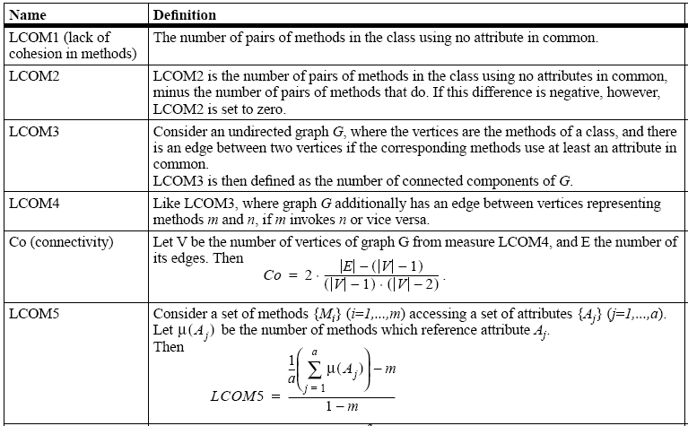
Some other cohesion metrics

Slide 45
Class Size
CS
Total number of operations (inherited, private, public)
Number of attributes (inherited, private, public)
May be an indication of too much responsibility for a class

Slide 46
Number of Operations Overridden
NOO
A large number for NOO indicates possible problems with the design
Poor abstraction in inheritance hierarchy

Slide 47
Number of Operations Added
NOA
The number of operations added by a subclass
As operations are added the subclass ‘moves away’ from the parent class
As depth increases NOA should decrease

Slide 48
Method Inheritance Factor
MIF = .
M_{i}(C_{i}) is the number of methods inherited and not overridden in C_{i}
M_{a}(C_{i}) is the number of methods that can be invoked with C_{i} (see next slide)
M_{d}(C_{i}) is the number of methods declared in C_{i} (see next slide)

Slide 49
MIF
M_{a}(C_{i}) = M_{d}(C_{i}) + M_{i}(C_{i})
Meaning: All that can be invoked = (new or overloaded) + things inherited
MIF is [0,1]
MIF near 1 means little specialization
MIF near 0 means large change

Slide 50
Coupling Factor
CF= .
is_client(x,y) = 1 iff a relationship exists between the client class and the server class. 0 otherwise
(TC²-TC) is the total number of relationships possible (where TC is the # of classes)
Entails relationships are not bidirectional
Formula calculates xproduct - diagonal
CF is [0,1] with 1 meaning high coupling

Slide 51
Polymorphism Factor
PF = .
M_{n}() is the number of new methods
M_{o}() is the number of overriding methods
DC() is the number of descendent classes of a base class
The factor is computed as the number of methods that redefine inherited methods, divided by the maximum number of possible distinct polymorphic situations (!!): ie assume all new methods are polymorphic!!

Slide 52
Operational Oriented Metrics
Average operation size (LOC, volume)
Number of messages sent by an operator
Operation complexity – cyclomatic
Average number of parameters/operation
The larger the number the more complex the collaboration

Slide 53
Measuring Encapsulation?
Lack of cohesion indicates potential lack of encapsulation
Consider % of public and protected
What would this indicate??
Public access to data members
What would this indicate??

Slide 54
Inheritance
Number of root classes
Fan in – multiple inheritance
NOC, DIT, etc.

Slide 55
Appendix

Slide 56
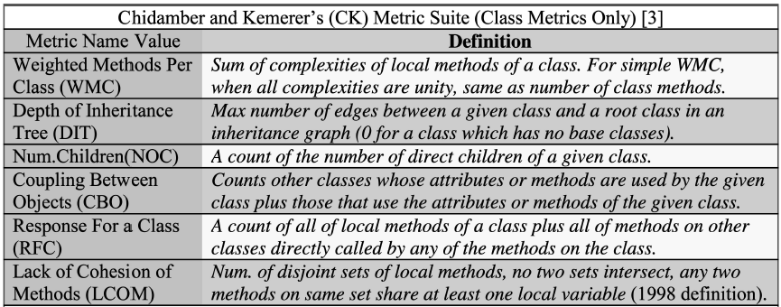
Main Results
Metric definitions – first suite:

Slide 57
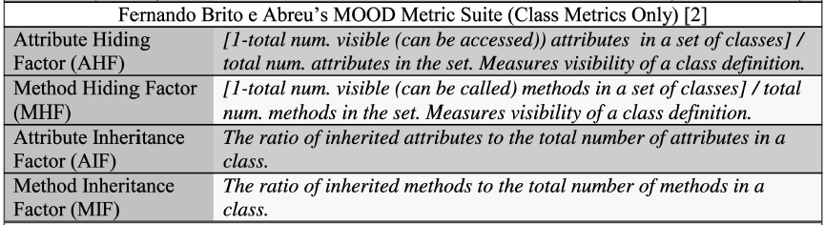
Main Results
Metric definitions – second suite:

Slide 58
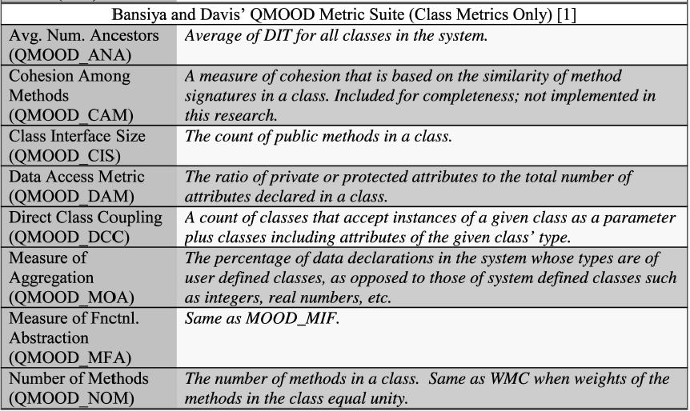
Main Results
Metric definitions – third suite:

Slide 59
Main Results
Software examined: Mozilla Rhino – an open source implementation of JavaScript written in Java
An example of the use of the agile software development in open source software
Six Rhino versions were analyzed in this case study
Delivery cycle time from 2 to 16 months

Slide 60
Main Results
Hypotheses:
Hypothesis 1: OO metrics can identify fault-prone classes in traditional and highly iterative or agile developed OO software during its initial delivery
Hypothesis 2: OO metrics can identify fault-prone classes in multiple sequential releases of OO software systems developed and using highly iterative or agile software development process

Slide 61
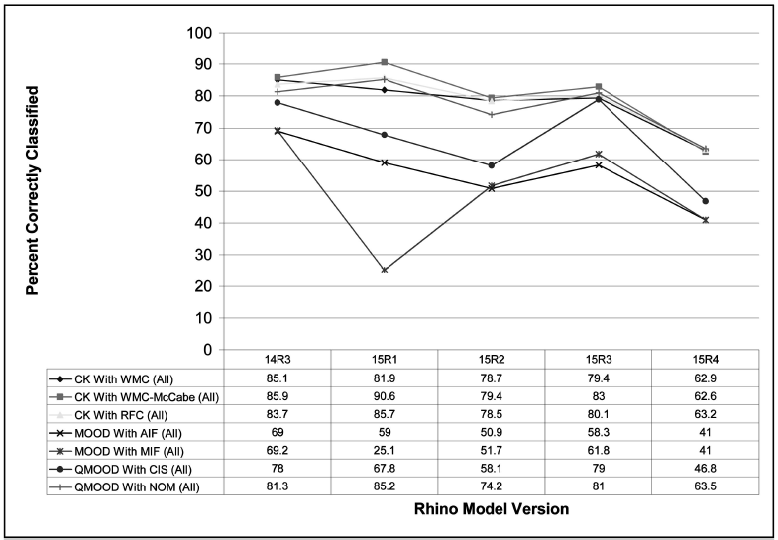
Main Results
Model validation:

Slide 62
Main Results
CK and QMOOD suites contain similar components and produce statistical models that are effective in detecting error-prone classes
MOOD metrics suite are not good class fault-proneness predictors
The produced models can be useful in assessing quality in OO classes developed using modern highly iterative or agile software development processes

